Slide 1
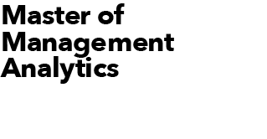


Team Amber: Datathon 2021
Assembling a new team for Toronto Six to face the new NWHL season
Bhavana Balakrishna Rao
Irene Jin
Yash Bhatnagar Zhenghao Zhang

Slide 2

INTRODUCTION
The target of this project is to help the coach of Toronto Six to form a new team for NWHL 2021-22 season.
The coach wants to select top five players that excel in all areas of the game:
At least three players should be expert in scoring goals.
At least two players should be excellent passers.
At least two players should be faceoff specialists.
At least one player should be takeaway specialist.

Slide 3
METHODOLOGY
The selection of the new team is an optimization problem. Linear Programming is used to select the top five players that satisfy all coach’s requirements. The model utilizes the top 10% players for the four metrics specified below, to predict the potential top 5 players for the coming season.
Scoring expert
Scoring expert is chosen based on total goals scored and successful shots.
Passing expert
Similarly, Passing expert is chosen based on total successful passes and successful pass percentage.
Faceoff specialist
Faceoff specialists are chosen in terms of total number of faceoff wins and successful win percentage.
Takeaway specialist
Takeaway specialist are chosen in terms of total number of takeaways.

Slide 4
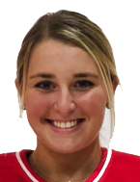
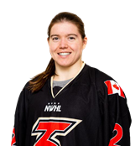
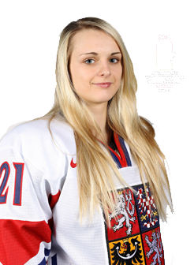
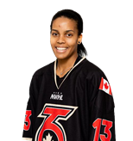

Top-5 players for Toronto Six (Season 2021-22)
Mikyla Grant-Mentis
Samantha Davis
Taylor Woods
Tereza Vanizova
Jillian Dempsey

Slide 5
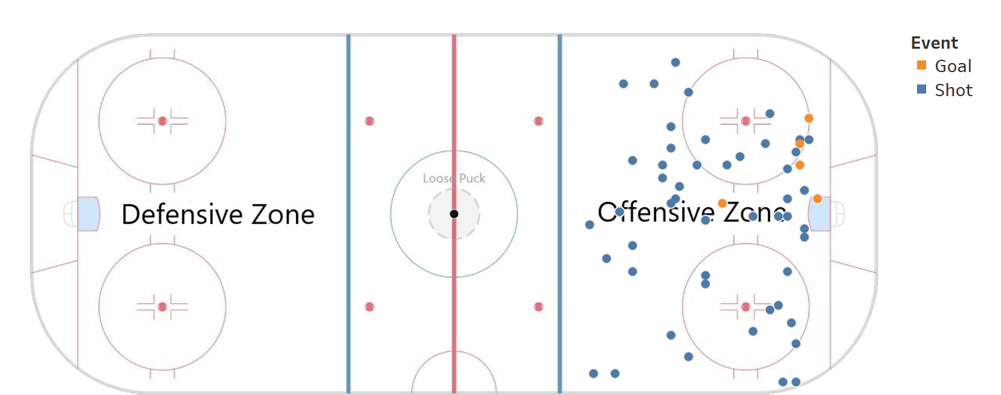
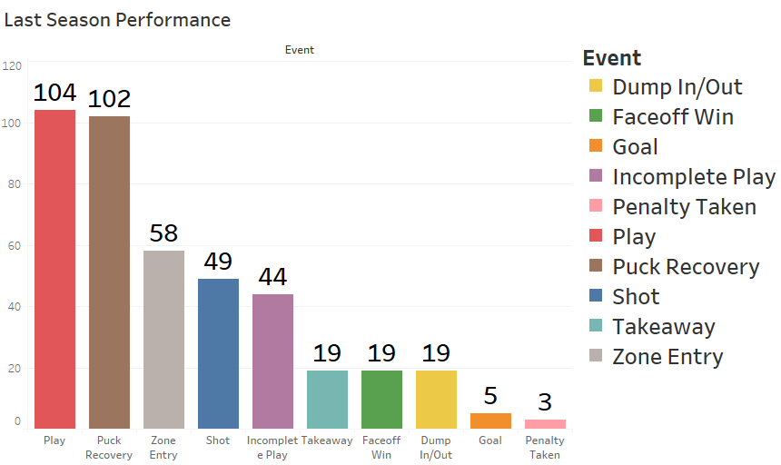
Mikyla Grant-Mentis (Goal Scorer)
Why Mikyla?
She is the highest goal scorer of 2020-21 season with 5 successful goals.
Accuracy of her shots is: 79.63%
She has the highest ‘shot on net’ in the last season.
She is a very offensive player and can be positioned as ‘center’ player. (She took majority of her shots in the middle of the field)

Slide 6
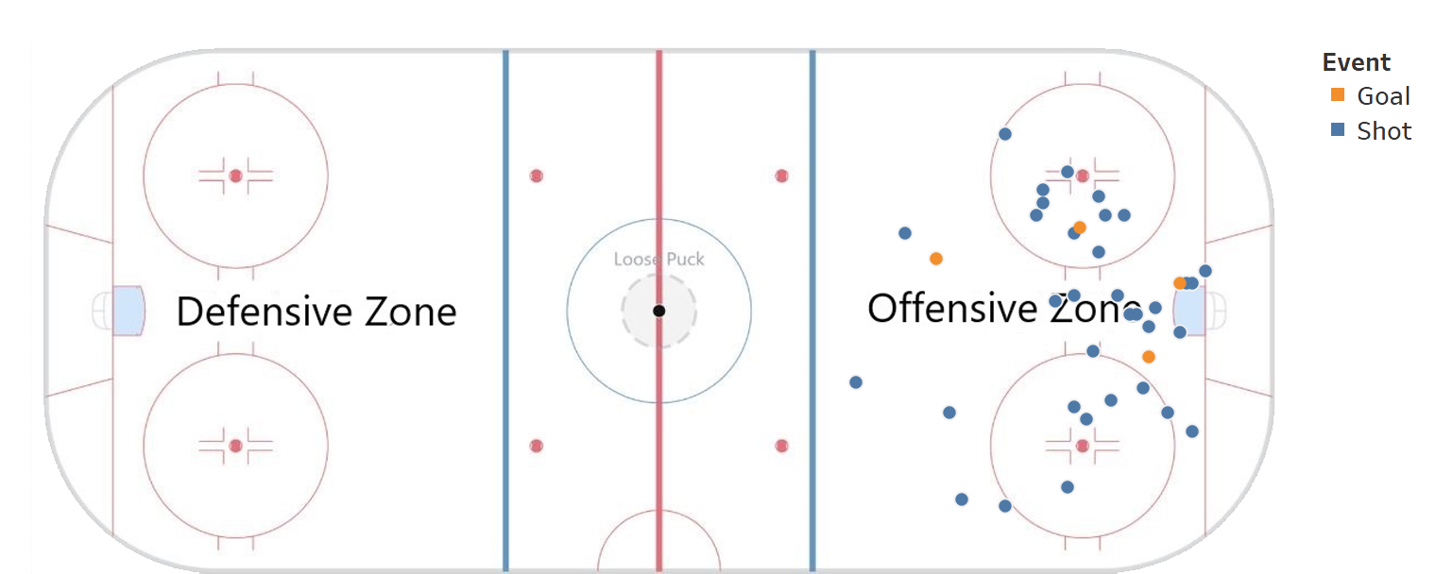
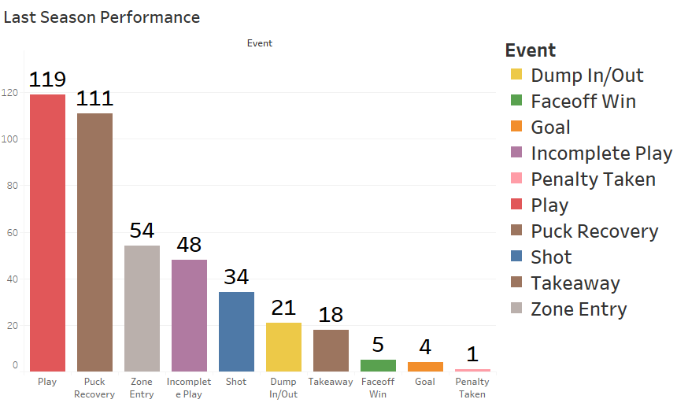
Samantha Davis (Goal Scorer)
Why Samantha?
She is the second highest goal scorer of 2020-21 season with 4 goals scored.
Accuracy of her shots is: 68.42%
She has demonstrated history of successful passes with one of the passer Tereza Vanisova.
She can also be used as ‘center’ player after Mikyla. (She took majority of her shots in the middle of the field)

Slide 7
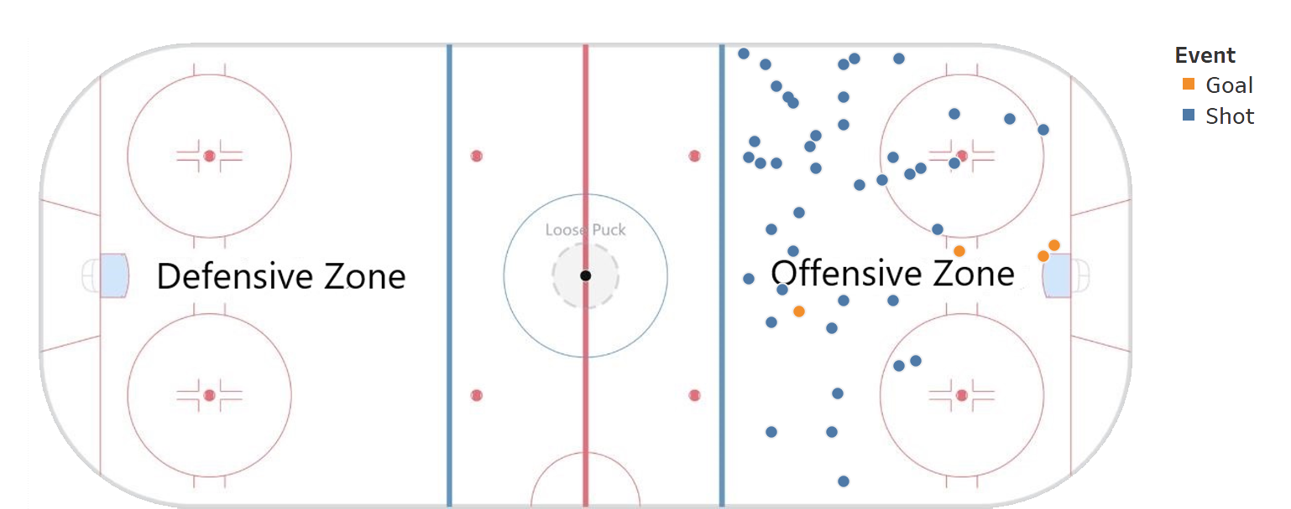
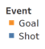
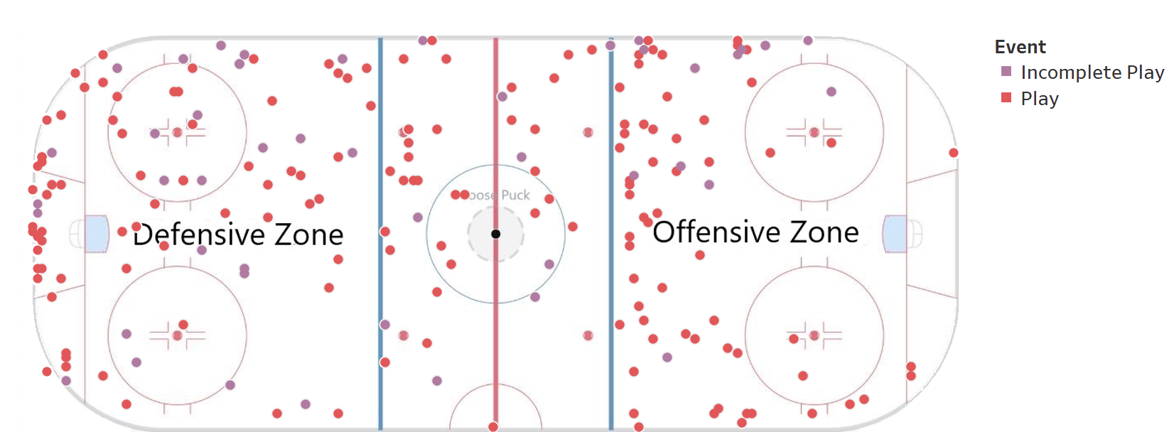
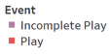
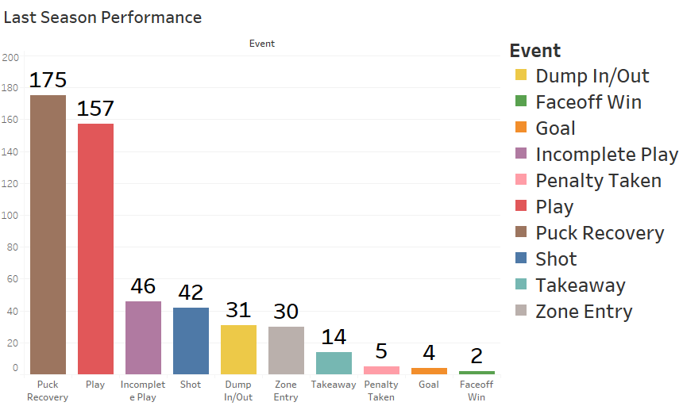
Taylor Woods (Goal Scorer & Passer)
Why Taylor?
She is also the second highest goal scorer of 2020-21 season with 4 goals scored. (Accuracy: 73.91%)
She is also a good passer and had 157 successful passes last season, which is the fourth most among all league players
Also, she made 27 successful passes to Mikyla in last season, and most of her passes were made in the Defensive and Neutral Zone.

Slide 8
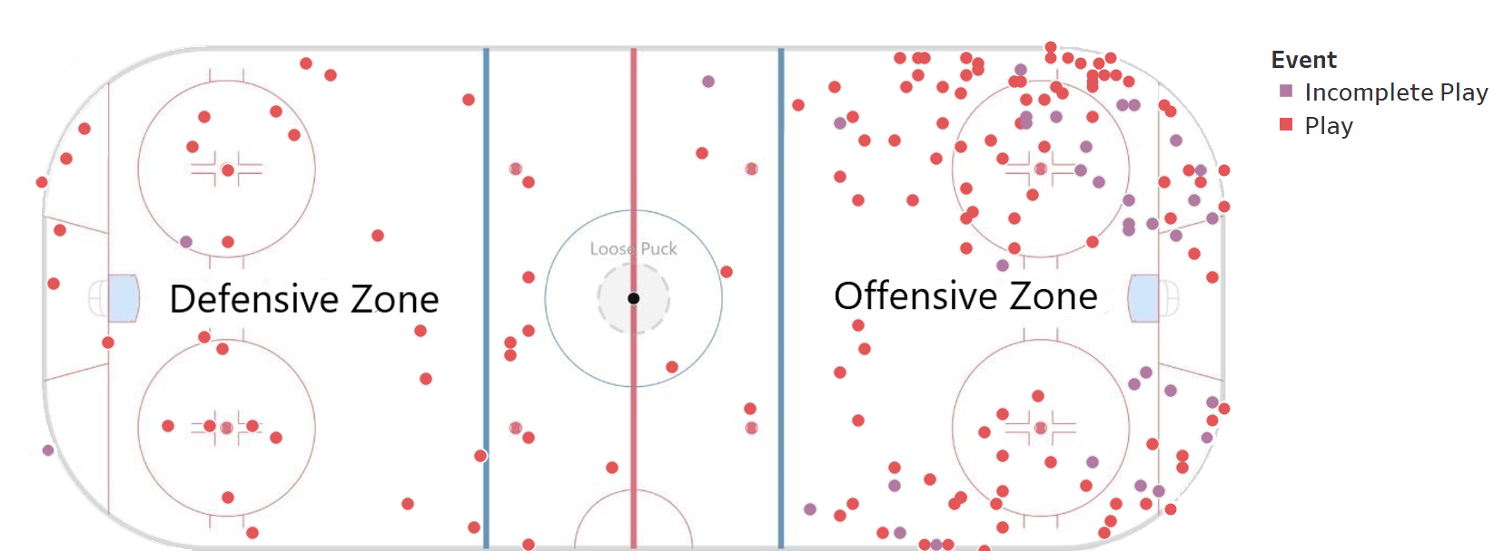
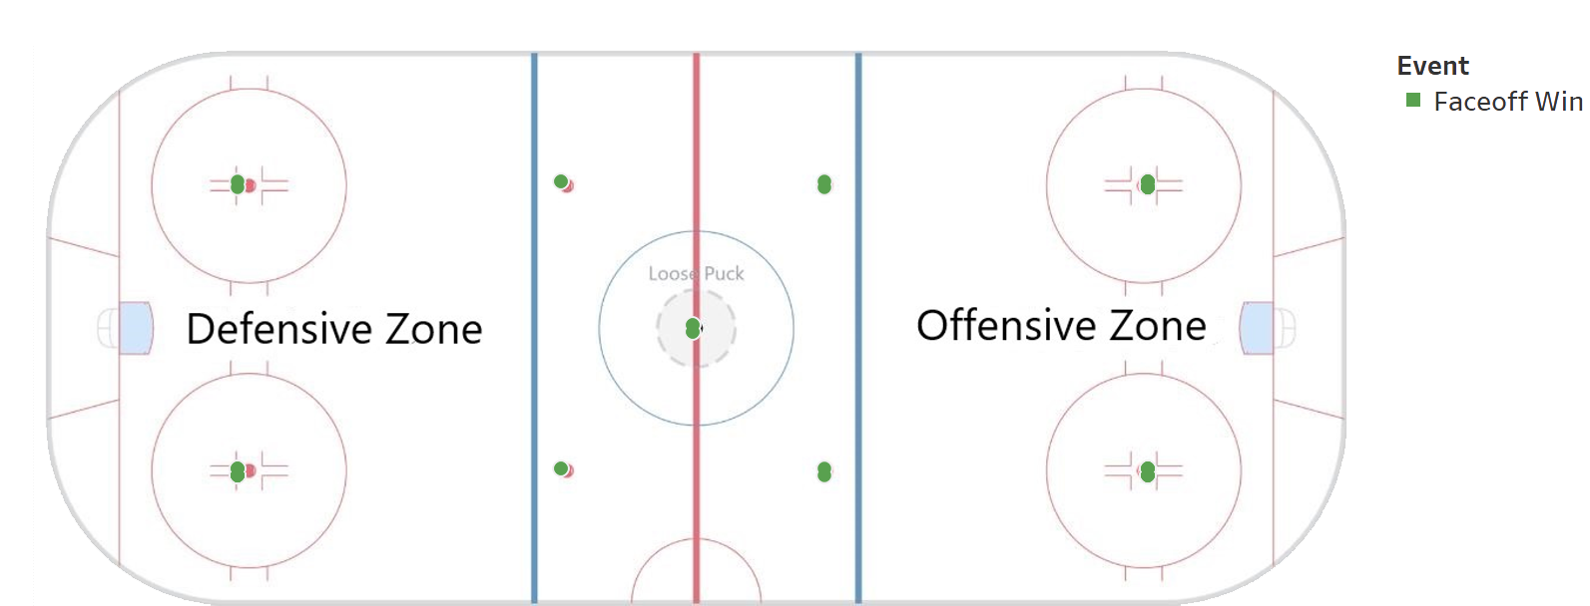
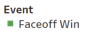
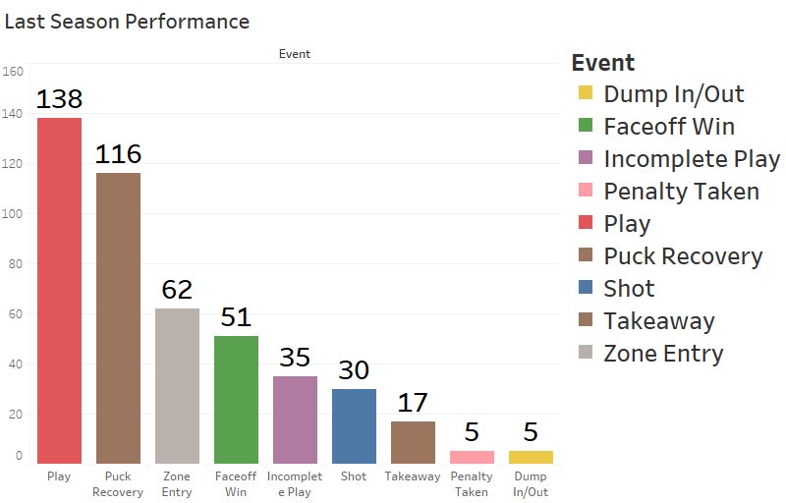
Tereza Vanisova (Passer and Faceoff Specialist)
Why Tereza?
She had 138 successful passes, and made 72% successful passes to Samantha in last season and 100% successful pass to Jillian.
She is an excellent faceoff specialist, as she has 51 successful faceoff wins last season, and she ranked no. 4 for faceoff wins.
Tereza will be an offensive passer in our team, and most of her passes were made in the ‘Offensive Zone’ for last season.

Slide 9
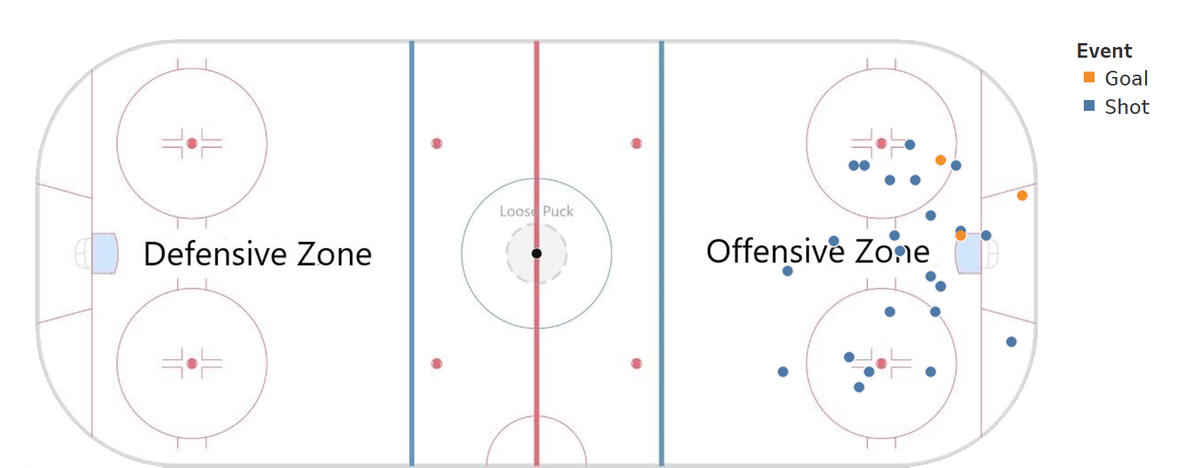
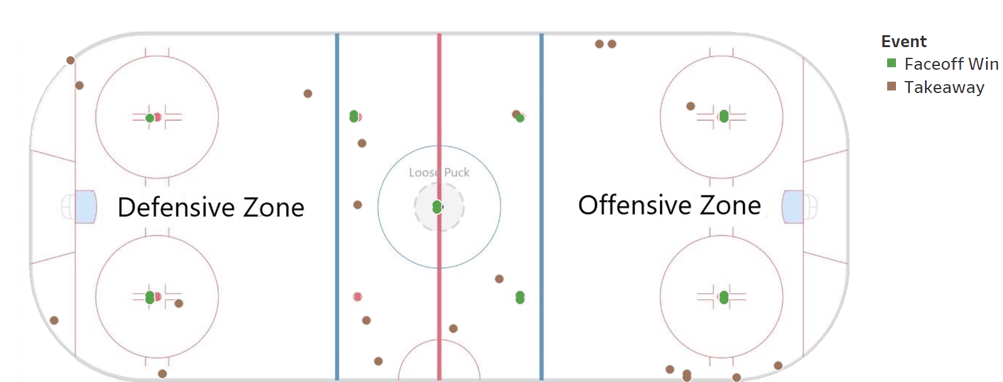
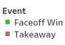
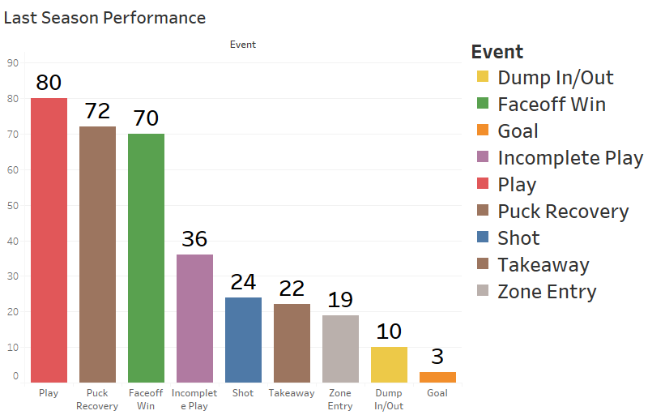
Jillian Dempsey (Goal Scorer, Faceoff & Takeaway Specialist)
Why Jillian?
She is the third highest goal scorer of 2020-21 season with 3 goals scored. (Accuracy: 77.78%)
She had 70 faceoff wins in last season, which is the second most among all players in the league
She had 22 takeaways in last season, which is one of the top 10 takeaway players

Slide 10
Appendix
The selection of the new team is a constrained optimization problem. The selection of players can be transformed into a Linear Programming Problem (LPP) using the following Decision Variables, Objective Function and Constraints. LPP is implemented using the PuLP library in Python.
Decision variables
Each of the available players are considered as decision variables.
The player variables are cast to integer variables. It can take the value 0 (not selected) or 1 (selected).
There are 126 players and each player is represented as x0, x1, x2, …. x125. Hence there are 126 decision variables.
Objective Function
Maximize the number of goals scored by the team.
The goals scored by each player is assigned to the respective decision variable to create the optimisation function. (Please find the function in .ipynb file)

Slide 11
Appendix
Constraints
Select a total of 5 players
At least 3 (i.e. 3 or more) players should be excellent goal scorers
The weighted average of: total number of goals scored with traffic, goals scored without traffic, percent of shots that reached the goal and shooting accuracy of the player, were taken in a normalized fashion in the ratio of 3:2:1:1 (As scoring a goal with traffic is more difficult), to calculate the potential of a player to score goals.
Top 10 % players (on the basis of above score) are considered as excellent scorers for our model.
At least 2 (i.e. 2 or more) players should be excellent passers
The weighted average of total number of successful passes (Play) and the percentage of successful passes among all pass attempts (pass percentage), in the ratio 2:1 is assigned to the respective decision variable of the player.
Top 10 % players (on the basis of above score) are considered as excellent passers for our model.
At least 2 (i.e. 2 or more) players should be faceoff specialist
The weighted average of total number of faceoff wins and the percentage of times that player has won faceoff was taken in an normalized fashion in the ratio of 2:1, to identify a potential faceoff specialist.
Top 10 % players (on the basis of above score) are considered as excellent faceoff specialist for our model.
At least 1 (i.e. 1 or more) player/players should be takeaway specialist
The total number of times a player has performed takeaway was used as a score to calculate a player’s takeaway potential.
Top 10 % players (on the basis of above score) are considered, i.e. a person who has done more than 20 takeaways, is considered as an excellent takeaway specialist for our model.

Slide 12
THANK YOU!

